Slide 1
Android RecyclerView
Niek Vandael
Bron: Udacity

Slide 2
Wat is een RecyclerView?

Slide 3
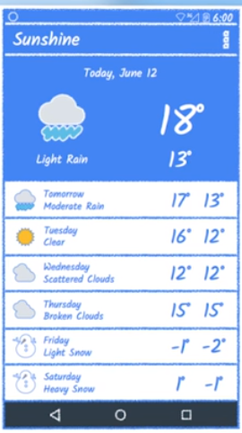
RecyclerView
Lijst van bijna-identieke items
Elk lijst-item is opgebouwd uit verschillende views
Enkel de relevate items laden (on-screen + cache)
Performance + memory gain

Slide 4
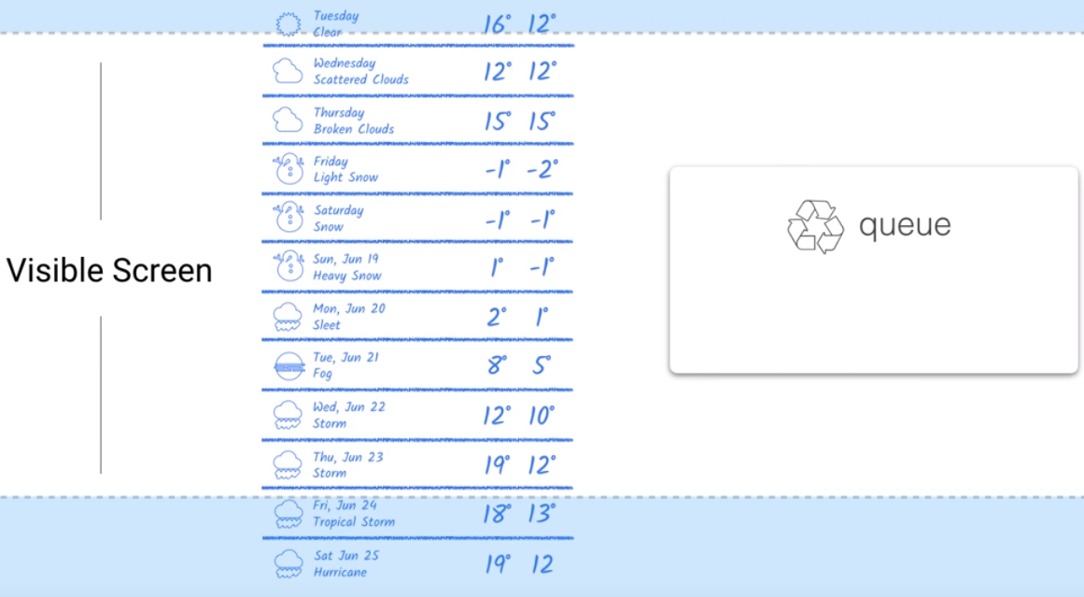
Recycling views

Slide 5
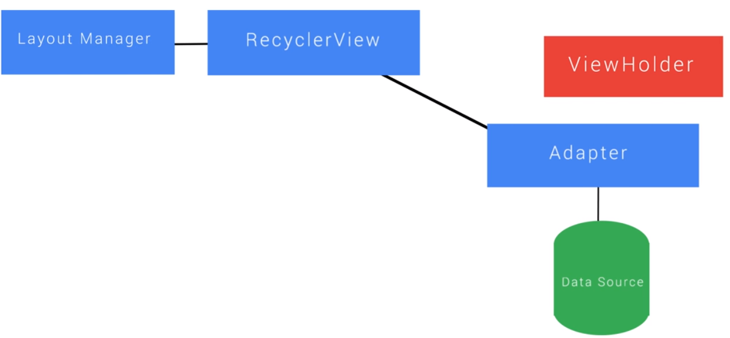
Componenten
Adapter: maakt nieuwe schermelementen
RecyclerView: Visueel element (volledige lijst)
Layout Manager: Toekennen v/d correcte layout aan de elementen
ViewHolder: de recycleerbare layout van een lijst-item

Slide 6
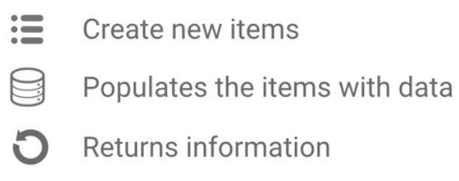
Adapter
OnCreateViewHolder: Wanneer een viewHolder wordt gemaakt
OnBindViewHolder: Vullen van het lijstelement met correcte data
GetItemCount: aantal elementen in datasource

Slide 7
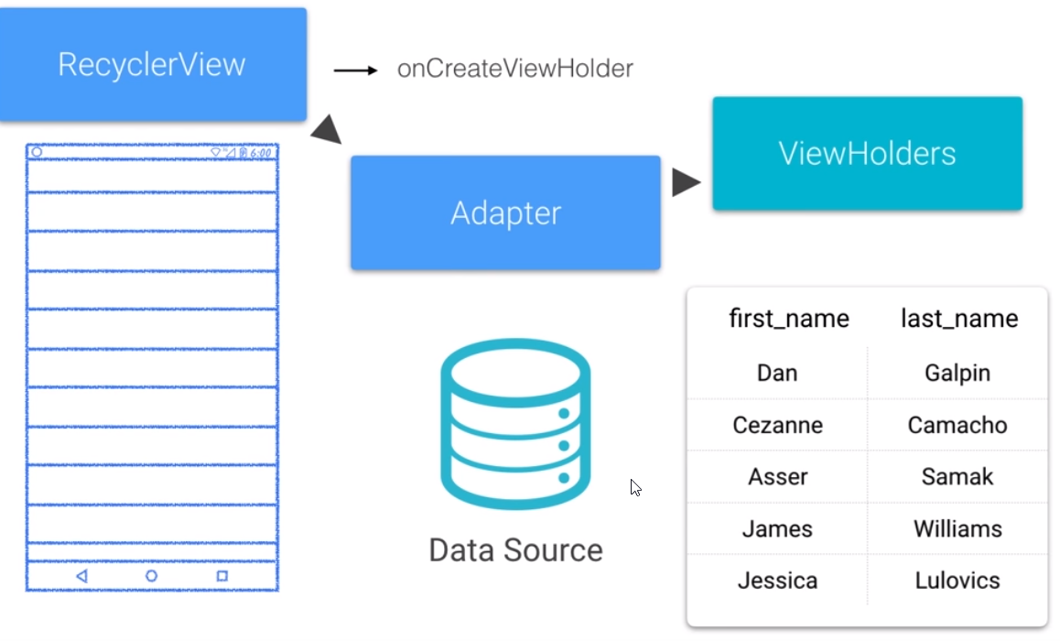
Adapter
1) RecyclerView vraagt Adapter hoeveel elementen er gedisplayed zullen worden
2) RecyclerView vraagt aan de adapter om ViewHolders te maken (OnCreateViewHolder)
3) RecyclerView vraagt aan de adapter om ViewHolders met data te voorzien (onBindViewHolder)
4) Tijdens het scrollen worden ViewHolders ‘gerecyleerd’ met nieuwe data

Slide 8
RecyclerView - implementatie

Slide 9
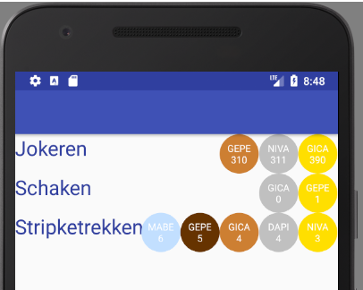

RecyclerView - implementatie
Build.gradle: toevoegen van RecyclerView (& Sync!)
activity_main.xml: een recyclerView gebruiken in je app
Notes:
<?xml version="1.0" encoding="utf-8"?> <RelativeLayout xmlns:android="http://schemas.android.com/apk/res/android" android:layout_width="match_parent" android:layout_height="50sp" android:gravity="right" android:orientation="horizontal"> <TextView android:layout_alignParentLeft="true" android:id="@+id/tv_name" android:layout_width="match_parent" android:layout_height="match_parent" android:layout_weight="1" android:fontFamily="sans-serif" android:layout_gravity="center_vertical|start" android:ellipsize="end" android:singleLine="true" android:textSize="26sp" android:textColor="@color/colorPrimaryDark" android:text="Name of the game placeholder"/> <TextView android:layout_alignParentRight="true" android:layout_marginRight="200sp" android:id="@+id/tv_pos5" android:layout_width="50sp" android:layout_height="50sp" android:layout_gravity="center_vertical|end" android:background="@drawable/circle" android:backgroundTint="@color/plastic" android:fontFamily="sans-serif" android:gravity="center" android:text="PLAYER" android:textColor="@android:color/white" android:textSize="12sp" android:visibility="invisible" /> <TextView android:layout_alignParentRight="true" android:layout_marginRight="150sp" android:id="@+id/tv_pos4" android:layout_width="50sp" android:layout_height="50sp" android:layout_gravity="center_vertical|end" android:background="@drawable/circle" android:backgroundTint="@color/wood" android:fontFamily="sans-serif" android:gravity="center" android:text="PLAYER" android:textColor="@android:color/white" android:textSize="12sp" android:visibility="invisible" /> <TextView android:layout_alignParentRight="true" android:layout_marginRight="100sp" android:id="@+id/tv_pos3" android:layout_width="50sp" android:layout_height="50sp" android:layout_gravity="center_vertical|end" android:background="@drawable/circle" android:backgroundTint="@color/bronze" android:fontFamily="sans-serif" android:gravity="center" android:text="PLAYER" android:textColor="@android:color/white" android:textSize="12sp" android:visibility="invisible" /> <TextView android:layout_alignParentRight="true" android:layout_marginRight="50sp" android:id="@+id/tv_pos2" android:layout_width="50sp" android:layout_height="50sp" android:layout_gravity="center_vertical|end" android:background="@drawable/circle" android:backgroundTint="@color/silver" android:fontFamily="sans-serif" android:gravity="center" android:text="PLAYER" android:textColor="@android:color/white" android:textSize="12sp" android:visibility="invisible" /> <TextView android:layout_alignParentRight="true" android:id="@+id/tv_pos1" android:layout_width="50sp" android:layout_height="50sp" android:layout_gravity="center_vertical|end" android:background="@drawable/circle" android:backgroundTint="@color/golden" android:fontFamily="sans-serif" android:gravity="center" android:text="PLAYER" android:textColor="@android:color/white" android:textSize="12sp" android:visibility="invisible" /> </RelativeLayout>

Slide 10

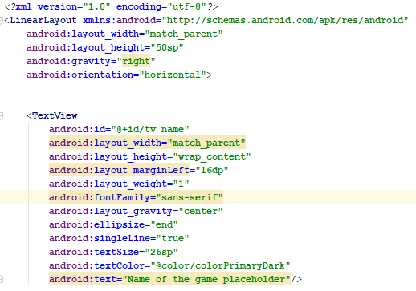
RecyclerView – layout van een rij
Rechtsklik op layout > new > layout resource file
Noem het bestand: <naam van je recylerView>_list_item
Dit bestand zal de layout van 1 rij bevatten
Notes:
<?xml version="1.0" encoding="utf-8"?> <LinearLayout xmlns:android="http://schemas.android.com/apk/res/android" android:layout_width="match_parent" android:layout_height="50sp" android:gravity="right" android:orientation="horizontal">
</LinearLayout> <TextView android:id="@+id/tv_name" android:layout_width="match_parent" android:layout_height="wrap_content" android:layout_marginLeft="16dp" android:layout_weight="1" android:fontFamily="sans-serif" android:layout_gravity="center" android:ellipsize="end" android:singleLine="true" android:textSize="26sp" android:textColor="@color/colorPrimaryDark" android:text="Name of the game placeholder"/>

Slide 11
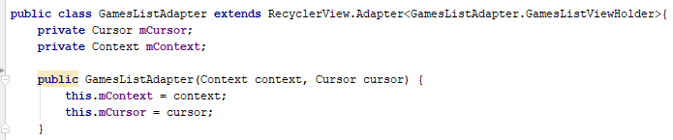
RecyclerView – ListAdapter (1)
Erf over van ‘RecyclerView.Adapter<T>’
De context (MainActivity) en cursor worden via de constructor geplaatst

Slide 12
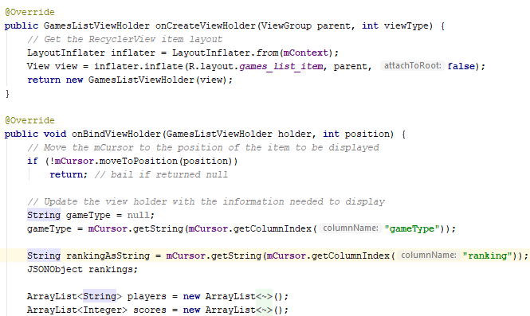

RecyclerView – ListAdapter (2)
1
onCreateViewHolder: maak nieuwe layouts aan per rij
onBindViewHolder: vul de nieuwe rijen op met data uit de cursor
Haal info uit de cursor via de colomn-index
2
3
3

Slide 13
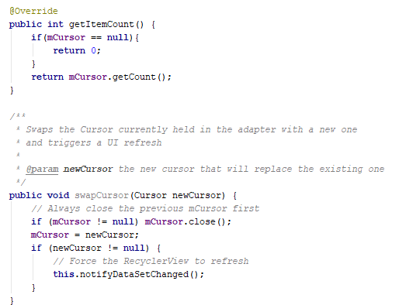
RecyclerView – ListAdapter (3)
getItemCount: Het aantal elementen in de cursor: nodig voor het bepalen van het aantal rijen
swapCusor: custom functie om nieuwe data in je lijst te plaatsen (nieuwe cursor = nieuwe data)
1
2

Slide 14
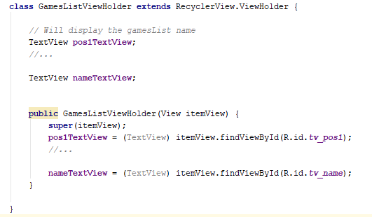
RecyclerView – ListAdapter (4)
Inner-class definitie van de viewHolder
Referenties naar de visuele elementen
Zoek de visuele elementen en plaats ze in de referenties
1
2
3
Notes:
package com.example.android.gamescores; import android.content.Context; import android.database.Cursor; import android.support.v7.widget.RecyclerView; import android.view.LayoutInflater; import android.view.View; import android.view.ViewGroup; import android.widget.TextView; import org.json.JSONArray; import org.json.JSONException; import org.json.JSONObject; import java.util.ArrayList; import java.util.Iterator; public class GamesListAdapter extends RecyclerView.Adapter<GamesListAdapter.GamesListViewHolder>{ private Cursor mCursor; private Context mContext; /** * Constructor using the context and the db cursor * @param context the calling context/activity * @param cursor the db cursor with waitlist data to display */ public GamesListAdapter(Context context, Cursor cursor) { this.mContext = context; this.mCursor = cursor; } @Override public GamesListViewHolder onCreateViewHolder(ViewGroup parent, int viewType) { // Get the RecyclerView item layout LayoutInflater inflater = LayoutInflater.from(mContext); View view = inflater.inflate(R.layout.games_list_item, parent, false); return new GamesListViewHolder(view); } @Override public void onBindViewHolder(GamesListViewHolder holder, int position) { // Move the mCursor to the position of the item to be displayed if (!mCursor.moveToPosition(position)) return; // bail if returned null // Update the view holder with the information needed to display String gameType = null; gameType = mCursor.getString(mCursor.getColumnIndex("gameType")); // COMPLETED (6) Retrieve the id from the cursor and String rankingAsString = mCursor.getString(mCursor.getColumnIndex("ranking")); JSONObject rankings; ArrayList<String> players = new ArrayList<String>(); ArrayList<Integer> scores = new ArrayList<Integer>(); try { rankings = new JSONObject(rankingAsString); Iterator<String> iter = rankings.keys(); while (iter.hasNext()) { String key = iter.next(); try { Integer value = rankings.getInt(key); players.add(key); scores.add(value); } catch (JSONException e) { // Something went wrong! } } } catch (JSONException e){ // Something went wrong! } if(players.size() >= 1){ holder.pos1TextView.setText(players.get(0) + "\n" + scores.get(0)); holder.pos1TextView.setVisibility(View.VISIBLE); } if(players.size() >= 2){ holder.pos2TextView.setText(players.get(1) + "\n" + scores.get(1)); holder.pos2TextView.setVisibility(View.VISIBLE); } if(players.size() >= 3){ holder.pos3TextView.setText(players.get(2) + "\n" + scores.get(2)); holder.pos3TextView.setVisibility(View.VISIBLE); } if(players.size() >= 4){ holder.pos4TextView.setText(players.get(3) + "\n" + scores.get(3)); holder.pos4TextView.setVisibility(View.VISIBLE); } if(players.size() >= 5){ holder.pos5TextView.setText(players.get(4) + "\n" + scores.get(4)); holder.pos5TextView.setVisibility(View.VISIBLE); } // Display the gamesList name holder.nameTextView.setText(gameType); // Display the party count // COMPLETED (7) Set the tag of the itemview in the holder to the id holder.itemView.setTag(mCursor.getString(mCursor.getColumnIndex("id"))); } @Override public int getItemCount() { if(mCursor == null){ return 0; } return mCursor.getCount(); } /** * Swaps the Cursor currently held in the adapter with a new one * and triggers a UI refresh * * @param newCursor the new cursor that will replace the existing one */ public void swapCursor(Cursor newCursor) { // Always close the previous mCursor first if (mCursor != null) mCursor.close(); mCursor = newCursor; if (newCursor != null) { // Force the RecyclerView to refresh this.notifyDataSetChanged(); } } /** * Inner class to hold the views needed to display a single item in the recycler-view */ class GamesListViewHolder extends RecyclerView.ViewHolder { // Will display the gamesList name TextView pos1TextView; TextView pos2TextView; TextView pos3TextView; TextView pos4TextView; TextView pos5TextView; // Will display the party size number TextView nameTextView; /** * Constructor for our ViewHolder. Within this constructor, we get a reference to our * TextViews * * @param itemView The View that you inflated in * {@link GamesListAdapter#onCreateViewHolder(ViewGroup, int)} */ public GamesListViewHolder(View itemView) { super(itemView); pos1TextView = (TextView) itemView.findViewById(R.id.tv_pos1); pos2TextView = (TextView) itemView.findViewById(R.id.tv_pos2); pos3TextView = (TextView) itemView.findViewById(R.id.tv_pos3); pos4TextView = (TextView) itemView.findViewById(R.id.tv_pos4); pos5TextView = (TextView) itemView.findViewById(R.id.tv_pos5); nameTextView = (TextView) itemView.findViewById(R.id.tv_name); } } }

Slide 15
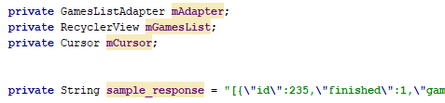
RecyclerView – MainActivity (1)
Instanties van de adapter, recyclerView & cursor → zullen via onCreate worden gevuld
Sample data
1
2

Slide 16
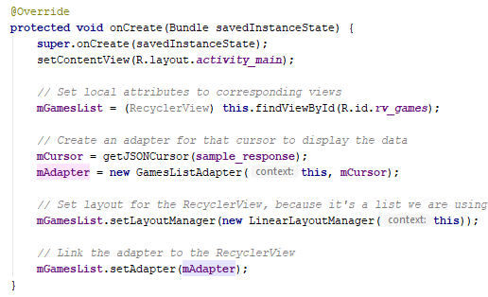
RecyclerView – MainActivity (2)
onCreate: wanneer de activity wordt gerendered
Zoek & vul de recylerView
Maak een nieuwe cursor adhv de sample-data
Maak een nieuwe adapter adhv deze activity & de cursor
Plaats een nieuwe layoutManager in de RecyclerView
Plaats de adapter in de RecyclerView
1
2
3
4
5
Notes:
package com.example.android.gamescores; import android.database.Cursor; import android.os.Bundle; import android.support.design.widget.FloatingActionButton; import android.support.design.widget.Snackbar; import android.support.v7.widget.LinearLayoutManager; import android.support.v7.widget.RecyclerView; import android.view.View; import android.support.design.widget.NavigationView; import android.support.v4.view.GravityCompat; import android.support.v4.widget.DrawerLayout; import android.support.v7.app.ActionBarDrawerToggle; import android.support.v7.app.AppCompatActivity; import android.support.v7.widget.Toolbar; import android.view.Menu; import android.view.MenuItem; import android.widget.EditText; import com.android.volley.Request; import com.android.volley.RequestQueue; import com.android.volley.Response; import com.android.volley.VolleyError; import com.android.volley.toolbox.StringRequest; import com.android.volley.toolbox.Volley; import org.json.JSONArray; import org.json.JSONException; import java.io.IOError; public class MainActivity extends AppCompatActivity{ private GamesListAdapter mAdapter; private RecyclerView mGamesList; private Cursor mCursor; private String sample_response = "[{\"id\":235,\"finished\":1,\"gameType\":\"Jokeren\",\"ranking\":{\"GICA\":390,\"NIVA\":311,\"GEPE\":310}},{\"id\":234,\"finished\":1,\"gameType\":\"Schaken\",\"ranking\":{\"GEPE\":1,\"GICA\":0}},{\"id\":233,\"finished\":1,\"gameType\":\"Stripketrekken\",\"ranking\":{\"NIVA\":3,\"DAPI\":4,\"GICA\":4,\"GEPE\":5,\"MABE\":6}}]"; @Override protected void onCreate(Bundle savedInstanceState) { super.onCreate(savedInstanceState); setContentView(R.layout.activity_main); // Set local attributes to corresponding views mGamesList = (RecyclerView) this.findViewById(R.id.rv_games); // Create an adapter for that cursor to display the data mCursor = getJSONCursor(sample_response); mAdapter = new GamesListAdapter(this, mCursor); // Set layout for the RecyclerView, because it's a list we are using the linear layout mGamesList.setLayoutManager(new LinearLayoutManager(this)); // Link the adapter to the RecyclerView mGamesList.setAdapter(mAdapter); } private Cursor getJSONCursor(String response){ try{ JSONArray array = new JSONArray(response); return new JSONArrayCursor(array); } catch(JSONException exception) { String ex = exception.getMessage(); } return null; } }

Slide 17
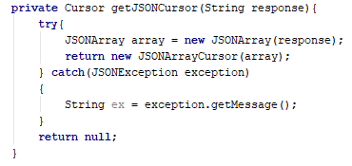
RecyclerView – MainActivity (3)
Maak gebruik van eender welke cursor in dit voorbeeld: custom JSONArrayCursor* Een cursor:
bevat de data van alle lijst elementen
bevat funtionaliteit om te navigeren
bevat funtionaliteit om data van een specifiek element te bekomen
* JSONCursor: https://gist.github.com/soeminnminn/e057ef7111d8f3e5701d
Notes:
package com.example.android.gamescores; import java.util.ArrayList; import java.util.Iterator; import java.util.List; import org.json.JSONArray; import org.json.JSONException; import org.json.JSONObject; import android.database.AbstractCursor; import android.os.Bundle; public class JSONArrayCursor extends AbstractCursor { public static final String DATA_KEY = "id"; private JSONArray mJsonArray; private String[] mColumnNames; private JSONObject mJsonObject; public JSONArrayCursor(JSONObject jsonObject) { if (jsonObject != null) { JSONObject tempObj = null; if(jsonObject.has(DATA_KEY)) { try { mJsonArray = jsonObject.getJSONArray(DATA_KEY); } catch (JSONException e) { e.printStackTrace(); } } if (mJsonArray == null) { try { tempObj = jsonObject.getJSONObject(DATA_KEY); } catch (JSONException e) { e.printStackTrace(); } if (tempObj != null) { mJsonArray = new JSONArray(); mJsonArray.put(tempObj); } } initialize(); } } public JSONArrayCursor(JSONArray jsonArray) { mJsonArray = jsonArray; try{ initialize(); } catch(Exception e) { String ex = e.getMessage(); } } private void initialize() { if (mJsonArray != null && mJsonArray.length() > 0) { JSONObject jsonObject = null; try { jsonObject = mJsonArray.getJSONObject(0); } catch (JSONException e) { e.printStackTrace(); } if (jsonObject != null) { Iterator<String> keys = jsonObject.keys(); if (keys != null) { List<String> list = new ArrayList<String>(); while(keys.hasNext()) { String key = keys.next(); list.add(key); } mColumnNames = new String[list.size()]; mColumnNames = list.toArray(mColumnNames); } } } } @Override public int getCount() { if (mJsonArray != null) { return mJsonArray.length(); } return 0; } @Override public String[] getColumnNames() { if (mColumnNames != null) { return mColumnNames; } return new String[] {}; } @Override public String getString(int columnIndex) { if (mJsonObject != null) { String name = getColumnName(columnIndex); if (name != null) { try { return mJsonObject.getString(name); } catch (JSONException e) { e.printStackTrace(); } } } return null; } @Override public short getShort(int columnIndex) { if (mJsonObject != null) { String name = getColumnName(columnIndex); if (name != null) { try { return (short)mJsonObject.getInt(name); } catch (JSONException e) { e.printStackTrace(); } } } return 0; } @Override public int getInt(int columnIndex) { if (mJsonObject != null) { String name = getColumnName(columnIndex); if (name != null) { try { return mJsonObject.getInt(name); } catch (JSONException e) { e.printStackTrace(); } } } return 0; } @Override public long getLong(int columnIndex) { if (mJsonObject != null) { String name = getColumnName(columnIndex); if (name != null) { try { return mJsonObject.getLong(name); } catch (JSONException e) { e.printStackTrace(); } } } return 0; } @Override public float getFloat(int columnIndex) { if (mJsonObject != null) { String name = getColumnName(columnIndex); if (name != null) { try { return (float)mJsonObject.getDouble(name); } catch (JSONException e) { e.printStackTrace(); } } } return 0; } @Override public double getDouble(int columnIndex) { if (mJsonObject != null) { String name = getColumnName(columnIndex); if (name != null) { try { return mJsonObject.getDouble(name); } catch (JSONException e) { e.printStackTrace(); } } } return 0; } @Override public boolean isNull(int columnIndex) { if (mJsonObject != null) { String name = getColumnName(columnIndex); if (name != null) { return mJsonObject.isNull(name); } } return true; } @Override public boolean onMove(int oldPosition, int newPosition) { if (mJsonArray == null) return false; if (oldPosition != newPosition || mJsonObject == null) { try { mJsonObject = mJsonArray.getJSONObject(newPosition); } catch (JSONException e) { e.printStackTrace(); } return true; } return false; } @Override public Bundle respond(Bundle extras) { Bundle result = new Bundle(); result.putString(DATA_KEY, toJSONString()); result.putInt("count", getCount()); result.putStringArray("columns", mColumnNames); result.putInt("position", mPos); result.putString("current", (mJsonObject != null) ? mJsonObject.toString() : ""); return result; } @Override public String toString() { if (mJsonArray != null) { return toJSONString(); } return super.toString(); } public String toJSONString() { if (mJsonArray != null) { JSONObject result = new JSONObject(); try { result.put(DATA_KEY, mJsonArray); } catch (JSONException e) { e.printStackTrace(); } return result.toString(); } return ""; } }

Slide 18
RecyclerView - onItemClick

Slide 19
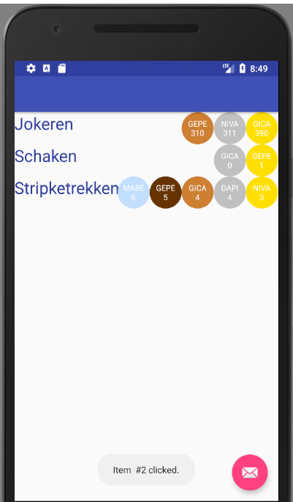
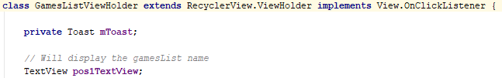
OnClick – ViewHolder (1)
Op de viewholder subclass: implementeer de interface ‘View.OnClickListener’
Maak een nieuwe Toast aan, deze kunnen we gebruiken om een boodschap te tonen wanneer er werd geklikt
1
2

Slide 20
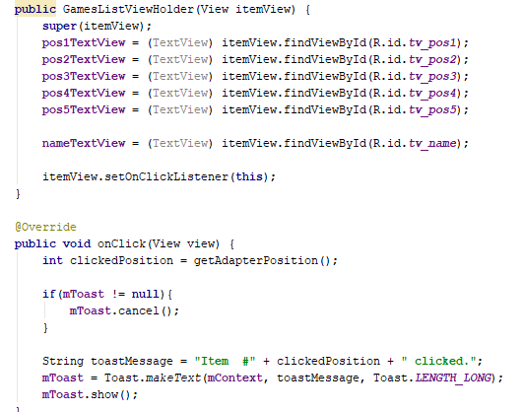
OnClick – ViewHolder (2)
Zet deze viewholder als onClickListener
Implementeer de onClick- methode dmv getAdapterPosition (3) kan je de index opvragen
1
2
3

